Slide 1
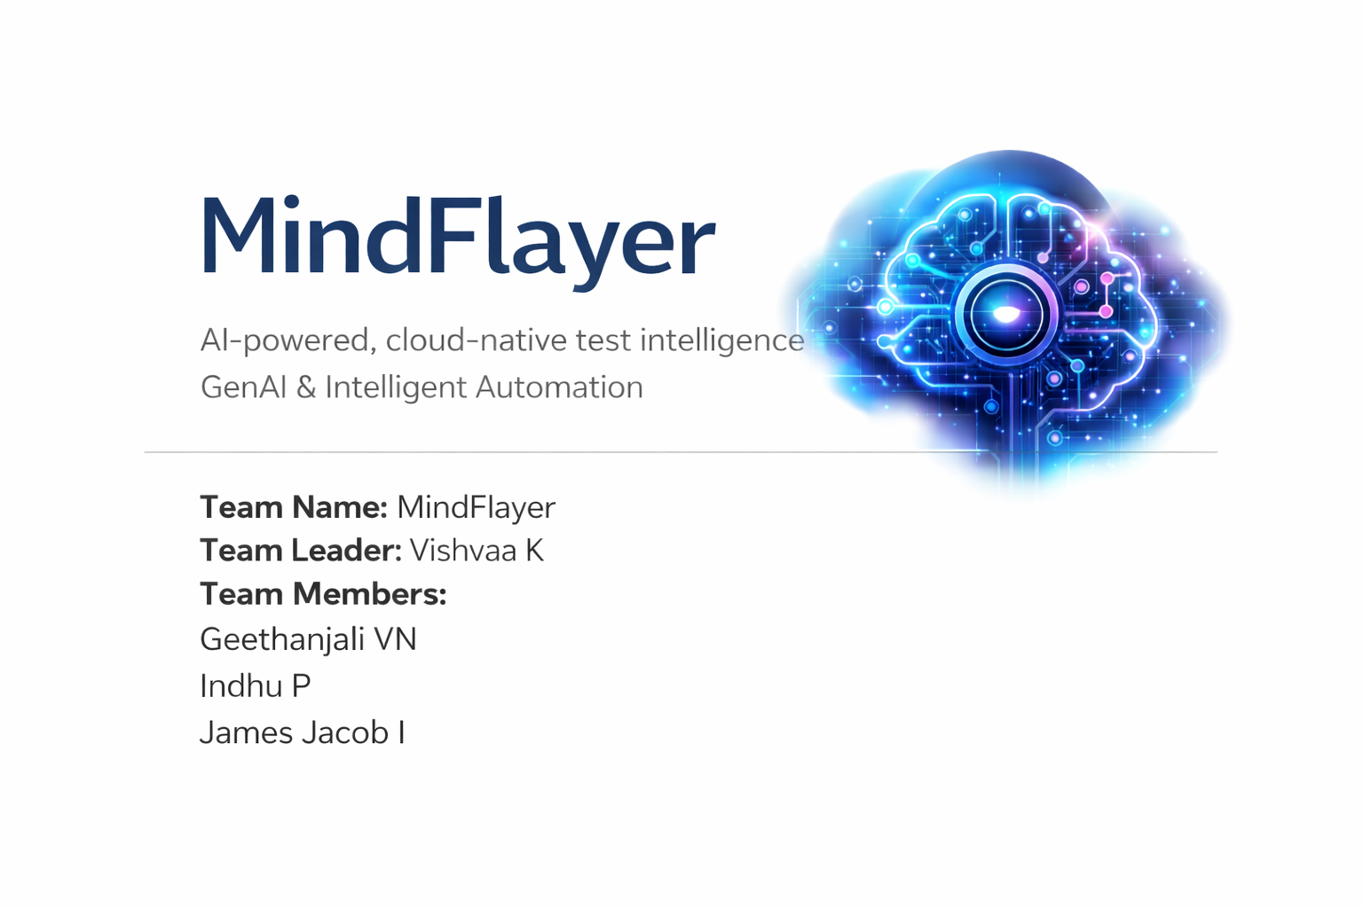
.

Slide 2
.
MindFlayer is a cloud-native, AI-powered test intelligence platform that uses Large Language Models to autonomously plan, generate, and validate API test cases from user stories and functional requirements.
Unlike traditional LLM-based tools, MindFlayer understands application context, identifies coverage gaps, and generates only missing, executable test cases, ensuring high test coverage with minimal manual effort.
MindFlayer – Bringing intelligent,context-aware test coverage to every API using autonomous LLM agents.
ReqSense - Analyzes user stories and API specifications to extract endpoints, constraints, and functional intent automatically.
ContextForge - Builds a complete system context by authentication rules, and existing test knowledge.
TestPlanner AI- Generates executable, production-ready API test code only for uncovered scenarios.
Validator Core - Verifies logical correctness and ensures complete, consistent test coverage.
Orchestrator - Coordinates all agents to deliver optimized, context-aware test automation.
Hi

Slide 3
hi
Problem Context
Why MindFlayer is Uniquely Powerful
Software teams lack intelligent, context-aware test automation that understands system behavior and existing test coverage.
current LLM tools generate generic or duplicate tests without knowing what is truly missing.
Agentic AI Architecture –Modular LLM agents handling planning, generation, and validation.
Context Awareness – Understands system behavior, dependencies, and existing test coverage.
Plan-Before-Generate – Decides required tests before writing any test code.
Executable Intelligence – Outputs ready-to-run PyTest or Postman test cases.
Enterprise Scalability –Designed for CI/CD pipelines and real-world systems.
How MindFlayer Bridges The Gap
Uses autonomous LLM agents to deliver context-aware test intelligence without hardcoded static templates.
Combines requirements, system context, and existing tests to understand real-world API behavior.
Generates only missing, executable tests, reducing redundancy and lowering maintenance effort.
Separates test planning from test generation, enabling smarter decisions over blind code output.
Agents operate independently, ensuring scalable, adaptable, enterprise-ready automation.
hello

Slide 4
.
Key Capabilities of MindFlayer
Context-Aware Test Intelligence Automatically builds system context from API requirements, including endpoints, authentication rules, and dependencies.
Intelligent Test Planning Determines which test cases should exist before generating any code. Plans positive, negative, authentication, dependency, and edge-case scenarios logically.
Duplicate-Free Test Generation Compares planned tests with existing test cases. Generates only missing tests, eliminating redundancy and maintenance overhead.
LLM-Driven Executable Test Code Uses Large Language Models to generate ready-to-run test code. Supports PyTest and Postman collections for immediate execution.
Coverage Gap Detection Identifies uncovered scenarios such as missing auth checks or token expiry cases. Ensures systematic and complete API test coverage.
,

Slide 5
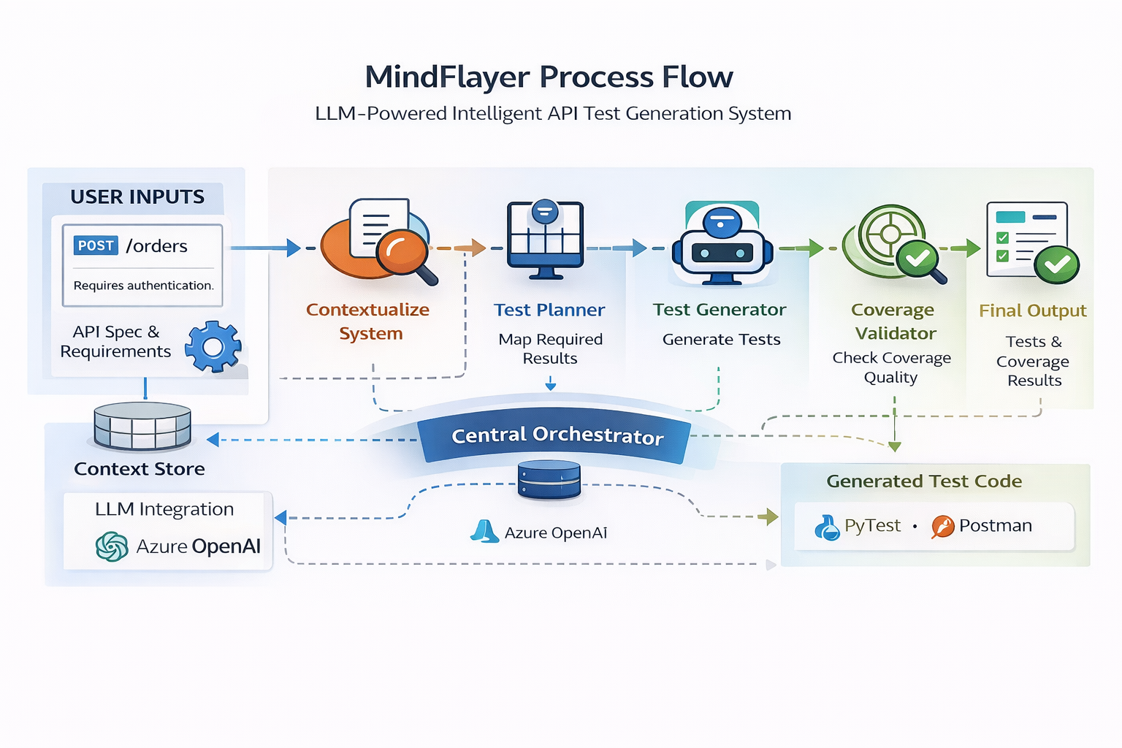
MindFlayer Process Flow Diagram

Slide 6
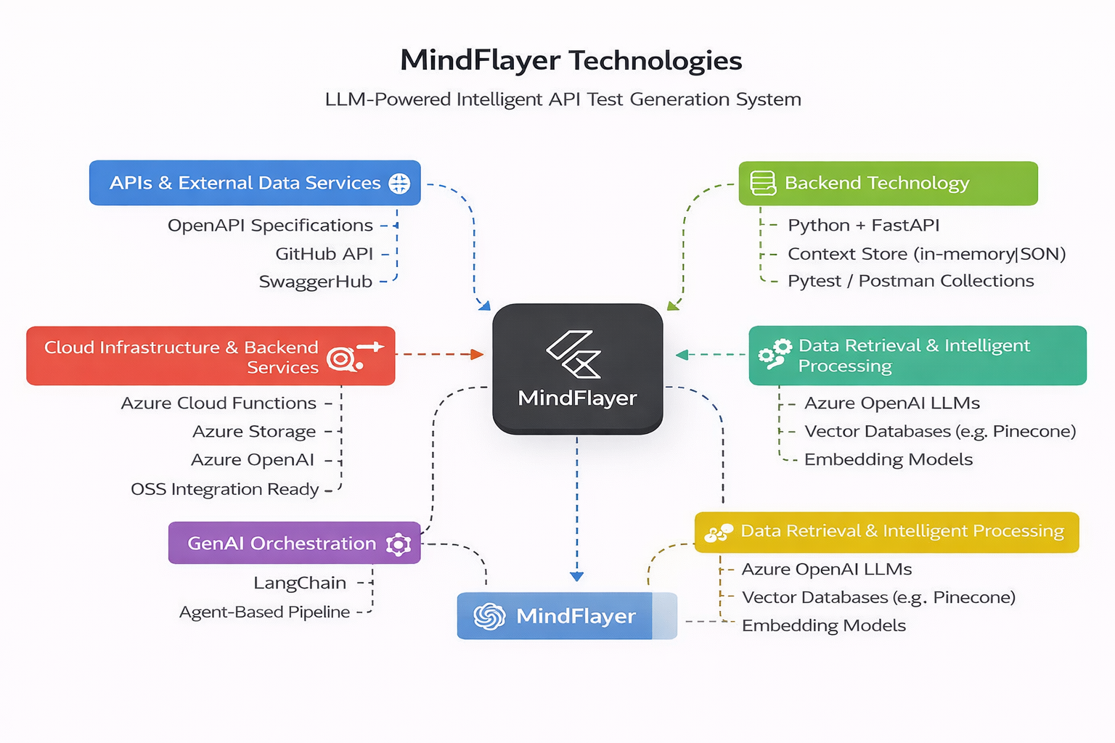
erprise Scalability – Designed for CI/CD pipelines and real-world systems.

Slide 7
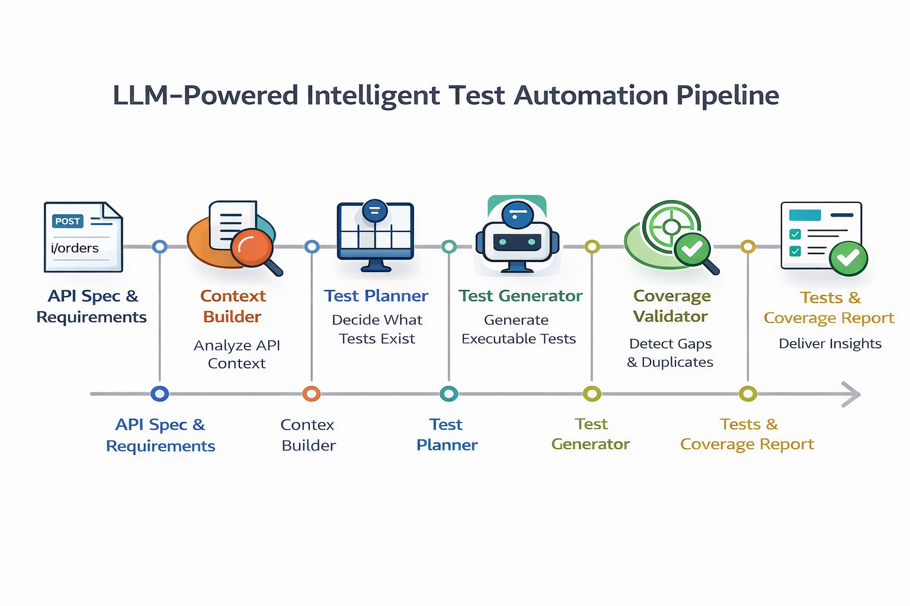

Slide 8
.
Impact & Real-World Use Cases
Impact :
Reduces manual API test creation and maintenance effort
Improves test coverage and software reliability
Accelerates CI/CD pipelines and release cycles
Use Cases :
Enterprise backend API testing
Microservices-based systems
Regression testing in CI/CD pipelines
SaaS product quality assurance teams
,

Slide 9
.
Scalability & Deployment Strategy
Deployed as a cloud-native service on Microsoft Azure.
Uses Azure OpenAI for scalable LLM inference.
Stateless services enable horizontal scaling.
Designed for seamless integration with CI/CD pipelines.
Supports enterprise-scale API ecosystems.
,

